Slide 1

Customer Purchase Behaviour Prediction in E-Commerce Platform using Machine learning
Presented by,
Zubariya Suleka Z

Slide 2
Problem statement
Given
Customer product purchase data in an ecommerce platform for the year 2024
Objective
To predict whether a customer will purchase the product or not by using machine learning models

Slide 3
Dataset
Size:
60000 x 51
Missing Data:
0
Duplicates:
0
Outliers:
0
Target variable:
Purchase_history

Slide 4
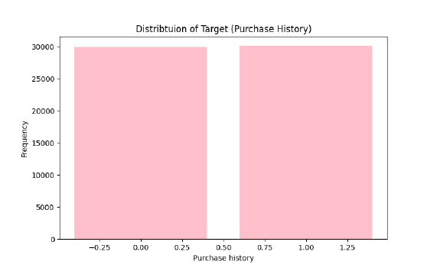
Exploratory Data Analysis
The Target is balanced data

Slide 5
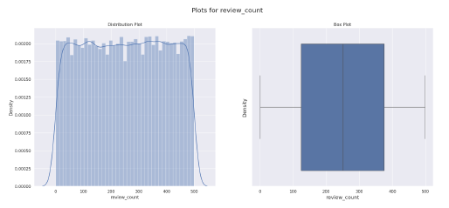
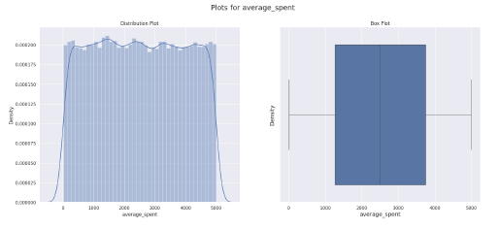
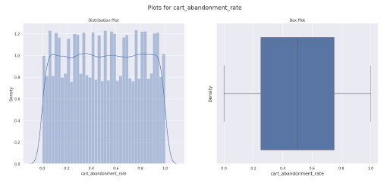
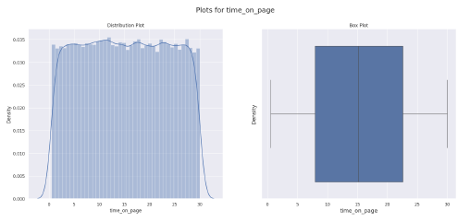
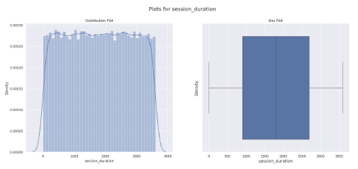
Univariate Analysis – Numerical columns

Slide 6
Univariate Analysis – Categorical columns

Slide 7
Feature Engineering
User based Features – user_total_interactions, user_total_spent, user_avg_review_count, etc
Product based Features - 'product_avg_rating', 'product_avg_review_count’ , etc
Time based features : ‘is_weekend’, ‘purchase_month’, ‘purchase_hour’
Target encoding for categorical columns due to high cardinality

Slide 8
Data Preparation
Separating Dependent/Independent variables
Splitting Training and Testing data
Train – 80%
Test – 20%
Feature scaling using StandardScaler

Slide 9
Model accuracy
Model | Training Accuracy | Test Accuracy
Logistic Regression | 90.6 | 90.3
Random Forest | 100 | 89.6
XGBoost | 98.9 | 89.3

Slide 10
Hyperparameter Tuning using Randomized SearchCV
Best Parameters: 'subsample': 1.0,
'reg_lambda': 5,
'reg_alpha': 1,
'n_estimators': 400,
'max_depth': 5,
'learning_rate': 0.01,
'colsample_bytree': 0.8
New XGBoost model with tuned parameters
  Train accuracy = 0.908
  Test Accuracy = 0.903
Significant Improvement in the accuracy after Hyperparameter tuning

Slide 11
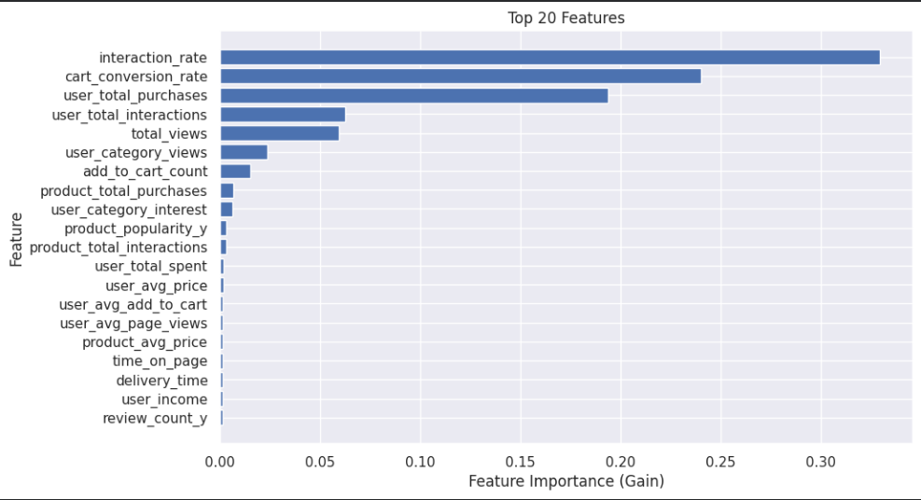
Feature Importance

Slide 12
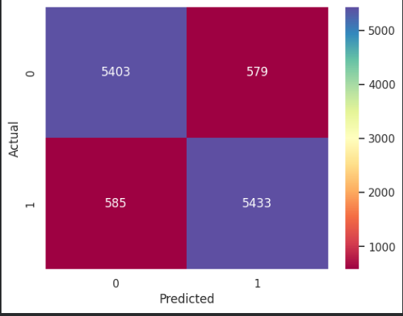
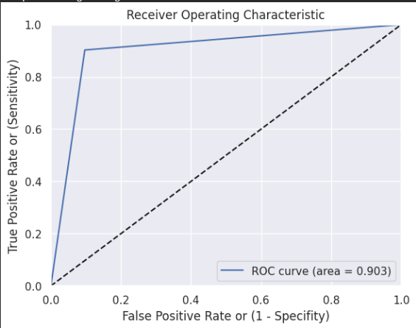
Confusion Matrix and ROC curve

Slide 13
Result
the XGBoost classifier delivered the best overall performance with a training accuracy of 90% and a test accuracy of 90%, indicating strong generalization without overfitting. The model achieved balanced precision and recall, confirming its reliability in identifying both purchasing and non-purchasing users
This classification model serves as a valuable foundation for understanding online customer behaviour and can be further integrated into a hybrid recommendation pipeline to enhance personalization and sales performance.

Slide 14
Personalized Product Recommendations Using Hybrid Filtering
Approach: Combine Collaborative Filtering (ALS) and Content-Based Filtering (Cosine Similarity) for personalized and contextual recommendations.
Collaborative Filtering (ALS):
  Built a user–product interaction matrix
  Learned latent factors representing user preferences and product similarities
Content-Based Filtering
  Calculated product similarity using attributes such as price, discount, rating, and category
  Applied cosine similarity to find similar products
Hybrid Model
  Combined CF and CBF scores:
  Final Score = 0.7 × CF + 0.3 × CBF
Added cold-start logic using product popularity and discounts for new users

